Slide 1
Sizewell C update 2023
Wickham Market Parish Council
  Richard Knight- Senior Community Relations Manager
  Richard Bull - Advanced Works & DCO Lead • SZC Project
  Zoe Botten – Community Relations Manager
  Monday 18th September 2023

Slide 2

Agenda
  Meet the READ Team
  Deed of Obligation
  Community Pledges
  Timelines
  Project Update
  Project Tracker

Slide 3
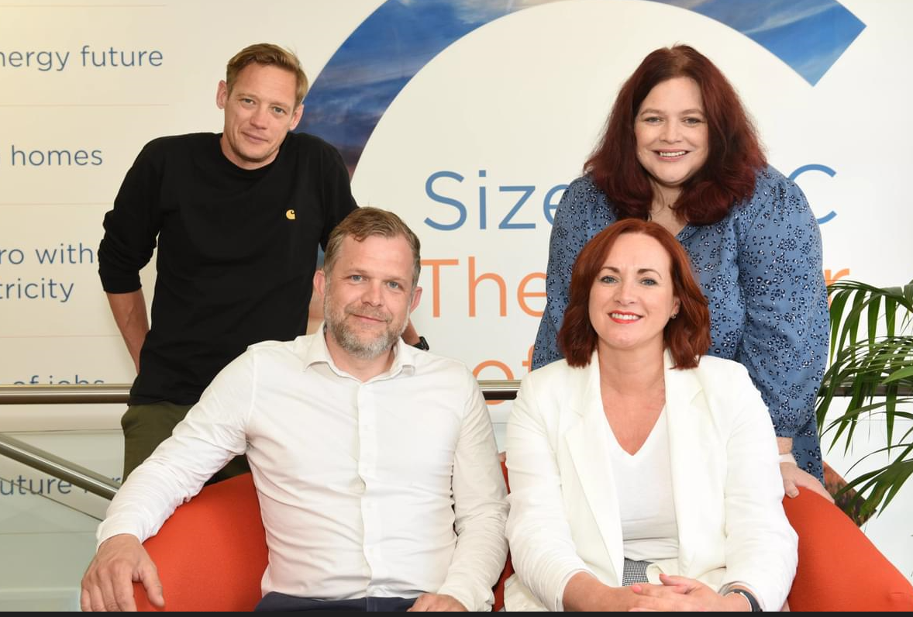
Community Relations Team
Paul Lennon – Michelle Emmerson Grey
Senior Community Relations Manager for Residents and
Land. Paul’s team is responsible for engaging with residents
and landowners regarding the project, addressing enquiries
and/or any concerns they have.
Richard Knight – Zoe Botten
Senior Community Relations Manager for
community governance and will engage with Parish
Councils and local authorities regarding project updates and the
future governance of the Deed of Obligation.

Slide 4
Effective Relationships
Accountability
Honesty
Listening
Open Communication
Trust
Mutual Respect

Slide 5
Deed of Obligation
Resourcing of local authorities
Accommodation
and Housing
Emergency
Services
Health and
Wellbeing
Public Services and Community Safety
Natural
Environment
Employment and skills
Tourism
Noise
Heritage
Transport
Community Fund
Leisure and
Amenity

Slide 6
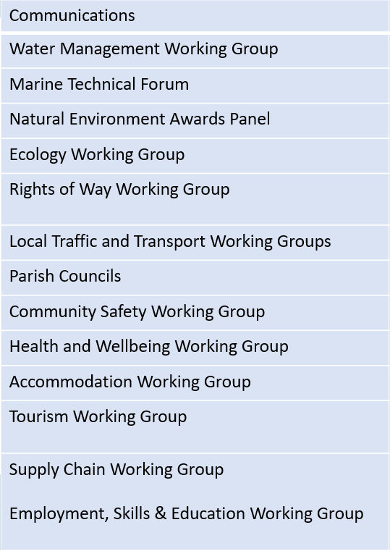
Working Groups
Planning Group
Community Forum (Annual)
Environment Review Group
Delivery Steering Group
Main Development Site
Forum
Transport Review Group
Northern Transport Forum
Social Review Group
Economic Review Group
Southern Transport Forum

Slide 7
Community
Pledges
Support the Suffolk coast tourism
sector to offset impacts from construction through the provision
of a Tourism Fund.
Transport the majority of construction materials by rail and sea, significantly reducing the number of Sizewell C HGVs on local roads.
Provide a comprehensive 24/7 onsite occupational health service for workers, a healthcare contribution and a Public Services Contingency Fund.
Minimize disruption to local communities during the construction of Sizewell C
Respect the Suffolk Heritage Coast and minimise impact on RSPB Minsmere, National Trust Dunwich Heath and Leiston Abbey.
Invest in local employment, education and skills. This includes an aim to enable 1,500 apprenticeships.
Require all workers to sign a Worker Code of Conduct and enforce it – as
we have done successfully at Hinkley Point C.
Return the temporary construction area to a standard befitting the Area of Outstanding Natural Beauty (AONB) following construction.
Support the growth of the local economy. This includes measures to support local firms in gaining work on the project.
Enhance the economic, social and environmental wellbeing of local communities through the provision of a Community Fund.
Remove the accommodation campus and caravan site, the park and ride sites, the rail extension of the Saxmundham to Leiston branch line and freight management facility following construction and restore the land.
The Sizewell C Project will not impact on the supply of water to local residents by a single drop. We have a sustainable strategy to provide potable water throughout construction and the operation of the new power station.’

Slide 8
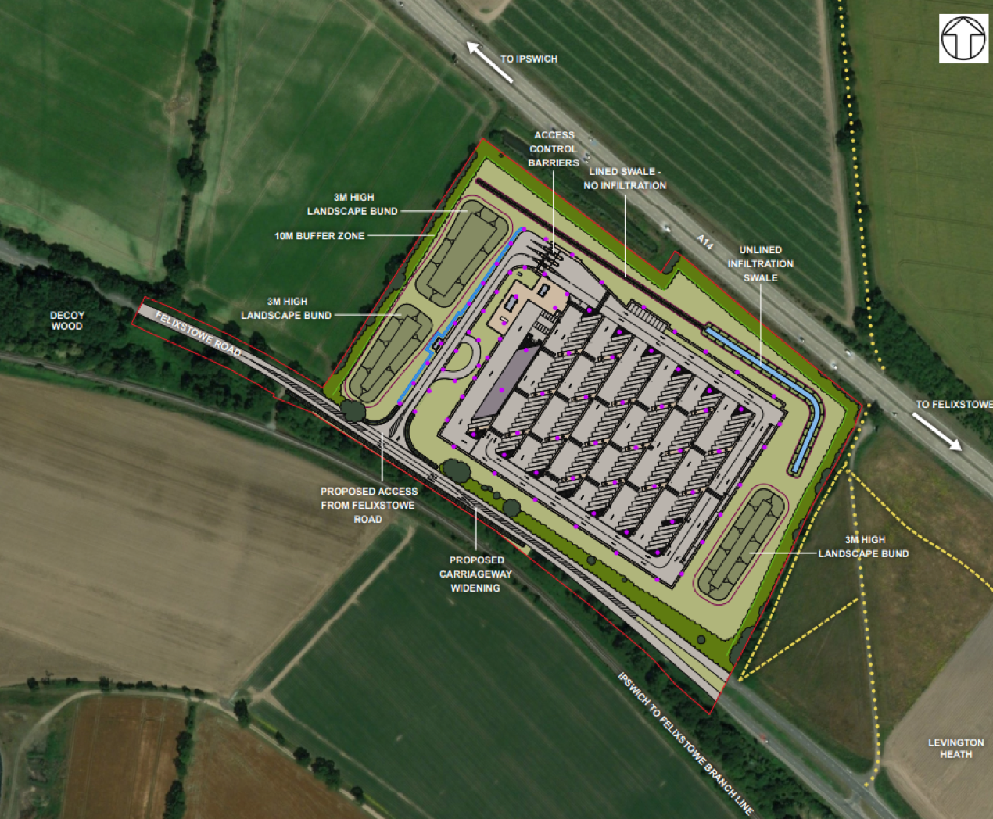
Freight Management Facility
A12 / A14 junction
Parking for 150 HGVs
Security and inspection of HGVs
Amenity and welfare building

Slide 9
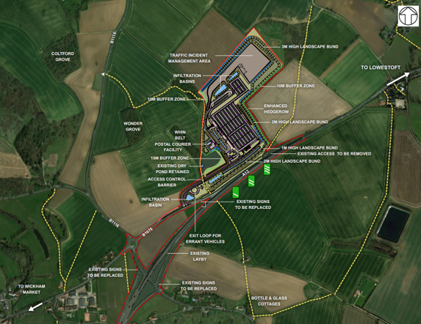
Southern Park and Ride
Located at Wickham Market
1250 car parking spaces
Postal Consolidation Centre
Traffic Incident Management Area

Slide 10
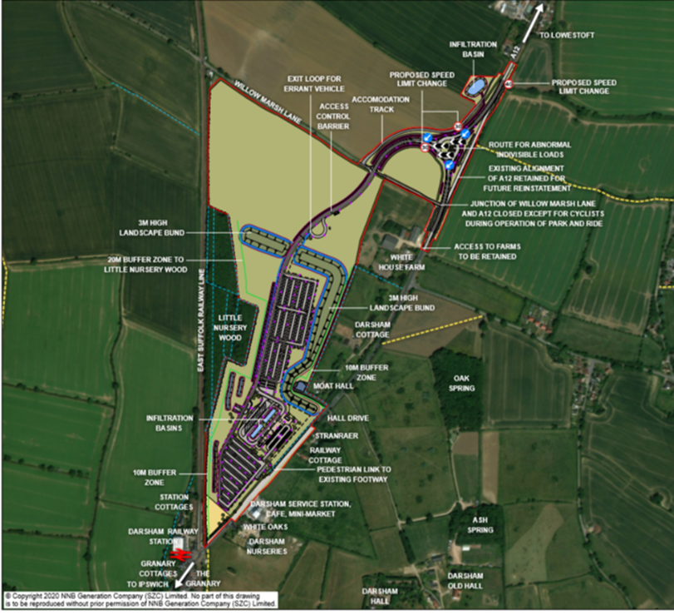
Northern Park and Ride
Located at Darsham
Car parking for up to 1,250 car parking spaces
Up to 10 spaces for minibuses/vans/buses.
Up to 80 motorcycle parking spaces.
Cycle shelters for up to 20 bicycles.
Bus terminus area, including shelters.
An amenity and welfare building.
A security building including an administration office.

Slide 11
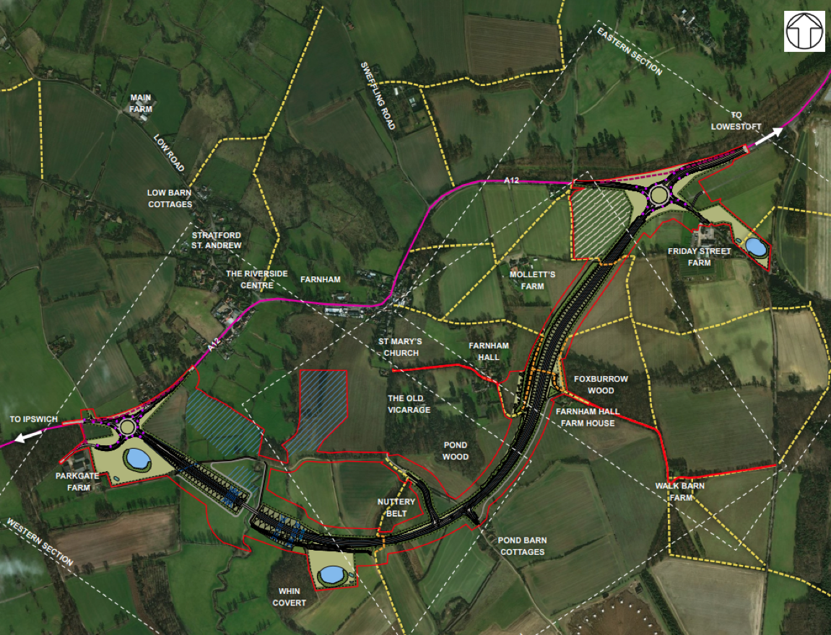
Two Village Bypass
Bypass of Farnham and Stratford St Andrew
2.4km in length
New 4 arm roundabout at Parkgate Fm and new 4 arm roundabout at Friday Street

Slide 12
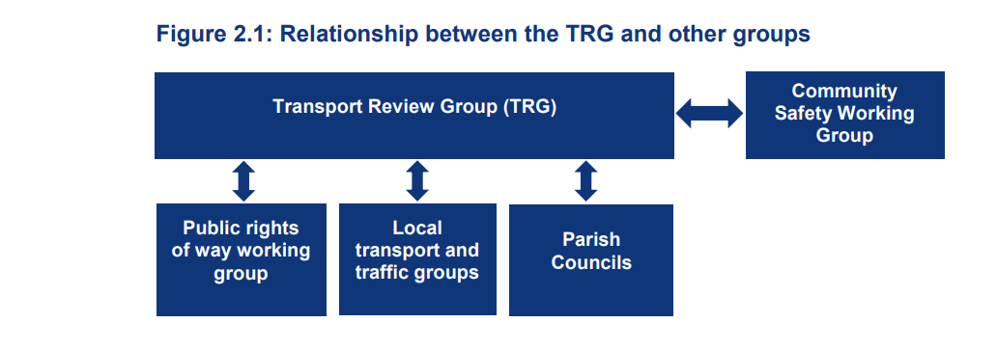
Construction Worker Travel Plan (CWTP)
• minimise the volume of traffic associated with the construction of the Sizewell C Project so far as reasonably practicable;
• maximise the sustainable movement of the construction workforce required for the construction of the Sizewell C Project so far as reasonably practicable
It is proposed that at induction, each worker will also be issued with a Sizewell C Travel Plan Pack which will include timetables, walking and cycle routes, parking, car sharing, and avoiding peak periods.

Slide 13
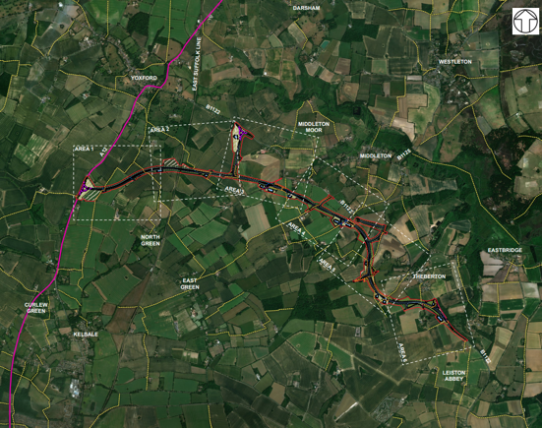
Sizewell Link Road
SLR is 6.8 km in length running from the A12 south of Yoxford to close to the main site entrance
The SLR includes a roundabout joining the A12, a single span railway bridge, a link from the SLR to the B1122 called the ‘Middleton Moor Link’
Potential to re-purpose the existing B1122 to be more cycling friendly with links into newly designated ‘Quiet Lanes’

Slide 14
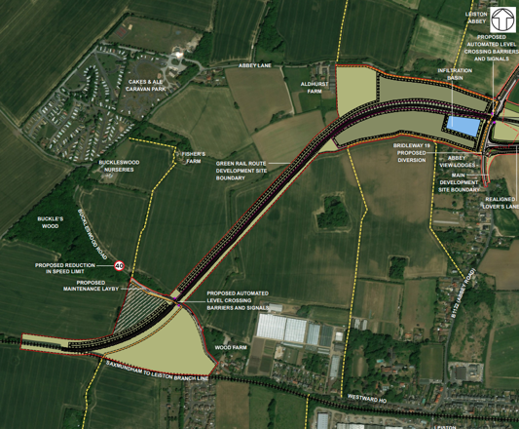
Green Rail Route
4.5km rail link from the Leiston branch line direct to the construction site

Slide 15
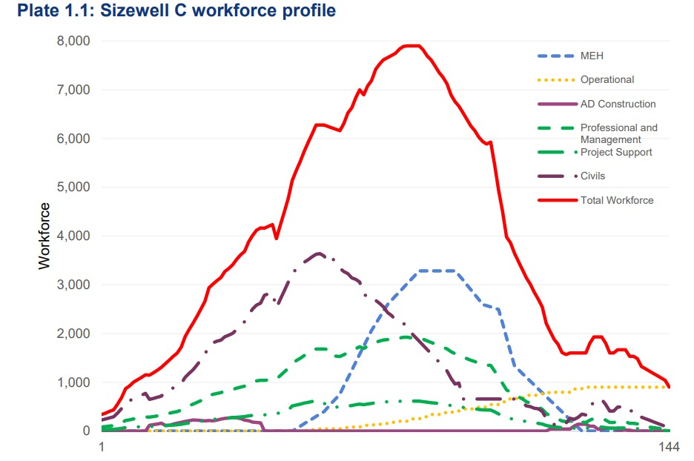
Accommodation and Housing
2400 bed accommodation campus, with a further 400 pitch caravan park available as temporary accommodation at peak
Housing Fund to increase the supply of bedspaces in the private rented and tourism sectors
East Suffolk Council to prepare housing plan for approval by the Accommodation Working Group
Contingency funding if SZC-provided accommodation delayed
Fund based on a worst-case scenario
A third of the workforce will come from the local area with an aim to exceed this figure.

Slide 16

Occupational Health Services
24/7 on-site occupational health service
Services will include a drop-in nurse-led treatment service, commonly-prescribed medication, GPs
Available to home-based workers as well as those living in Sizewell C-provided accommodation
Drug and alcohol testing
Further services incorporated as workforce grows
Additional funding to support local health services

Slide 17
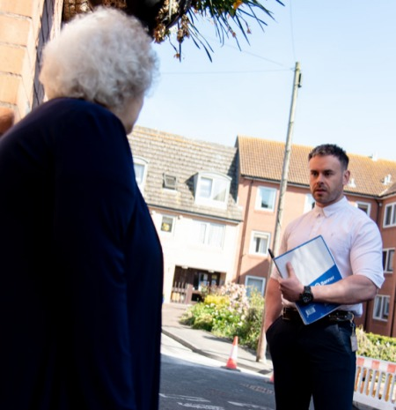
Emergency Services and Community Support
Funding for emergency services in East Suffolk. Locality Sgt in post and working closely with the Community Relations Team
Police reserve funding
Community Safety Officer will work with local stakeholders to address concerns
Resources devoted to council-led initiatives that reduce crime and anti-social behaviour
Pressures on education and social care addressed through a resilience fund
Construction workforce will sign a Worker Code of Conduct

Slide 18
Workforce Conduct
The conduct of the SZC workforce in the community is of the highest importance. It is for that reason that everyone involved with the SZC Project is expected to:
Be responsible for your safety and the safety of others by complying with all applicable laws, rules, and regulations;
Be ambassadors for the project through your behaviour and actions on site and in the community, including in the use of social media
Refrain from anti-social behaviour, discriminatory behaviour or harassment on and off site
Ensure that they are not intoxicated by alcohol or under the influence or illegal drugs
Respect colleagues and endeavour to maintain harmonious workplace relations at all times
Ensure that rented accommodation is maintained in a tidy state with the proper disposal of rubbish
Ensure that personal noise levels are appropriate to the time of day and location
Ensure no damage of any kind is caused to property on the off site
Respect speed limits and be aware of other road users, agricultural vehicles and livestock
    ‘By attending and completing the SZC Site Induction and receiving access to SZC site you are confirming your commitment to the expectations described above’’.

Slide 19
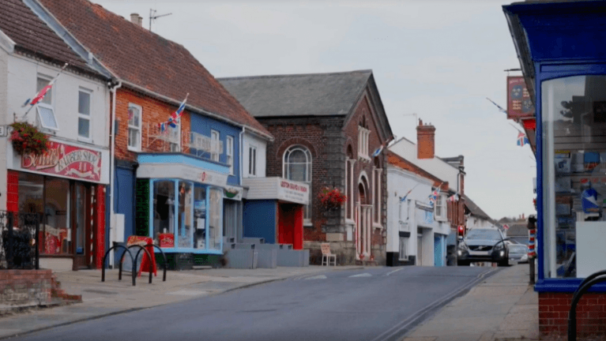
Community Fund
£23mn for projects that promote the economic, social or environmental wellbeing of East Suffolk to filter through the lifetime of the project
Administered by Suffolk Community Foundation; public representatives on the funding panel
Further support from Community Action Suffolk and East Suffolk Community Partnerships
Focused where impacts are greatest
Small grants, Open grants, Strategic grants covering different purposes

Slide 20
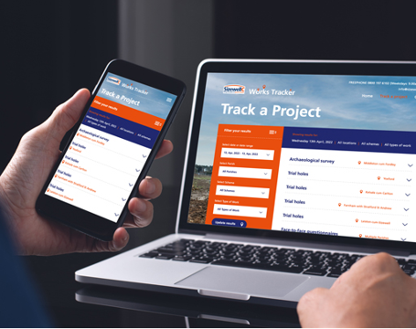
Project updates
New online works tracker to keep local communities informed about surveys and other preparatory works
Contact our Leiston office – info@sizewellc.co.uk or 0800 197 6102

Slide 21
Thank you

