Slide 1
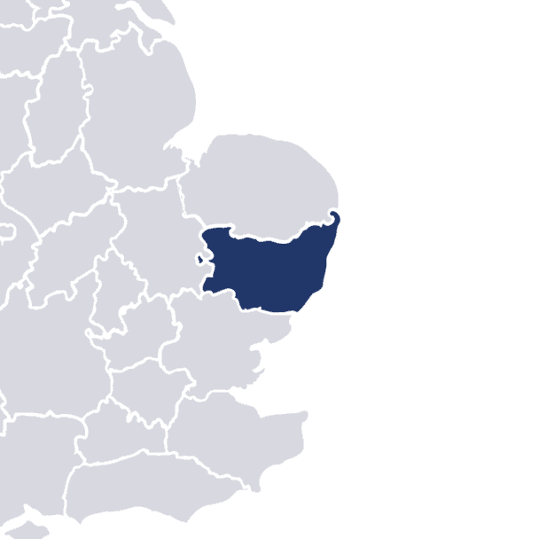

Wickham Market
High Street –
Potential Approach
July 2020

Slide 2
Contents
Existing situation on Wickham Market High Street
Topographical survey and cross-section results
Design considerations
Toolkit of potential measures

Slide 3
Existing Features and Characteristics

Slide 4
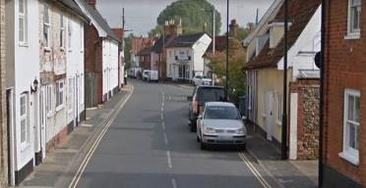
Existing Characteristics of B1078 High Street
Study area B1078 from Border Cot Lane to B1116 roundabout
3,650 vehicles per day (2015 data presented at Stage 4)
Two slight-severity accidents recorded in 5 years, both involving cyclists
30mph speed limit along the entire length
Double-decker bus route (63/64 Ipswich <-> Aldeburgh)
Bus stop flag and cage on westbound side; flag only eastbound
Centre line marked except for where formal kerbside bays exist
Primarily residential; mainly older buildings with some new development
Some very narrow footways: not wide enough for pedestrians to pass one another
Little protection from traffic for building frontages
Some parking up on the footway
No dedicated facilities for pedestrians to cross safely
Blind accesses difficult to enter/exit safely

Slide 5
Design Objectives

Slide 6
Wickham Market – Design Objectives
Safer, more pleasant walking routes and crossing opportunities
Improved public realm for local residents
Greater protection for building frontages from passing traffic
Suitable parking designed to accommodate residents’ needs
Discourage through traffic and encourage safe speeds when passing through the village
Active consideration of cyclists’ needs travelling along B1078
Wayfinding for visitors
Improved provision for bus users
Design constraints:
No vertical deflection (speed humps / rumble strips) to minimise vibrations
Consideration of both maintenance and installation costs
Limited width between building frontages
Need to accommodate some large vehicles (farm equipment and double decker buses)

Slide 7
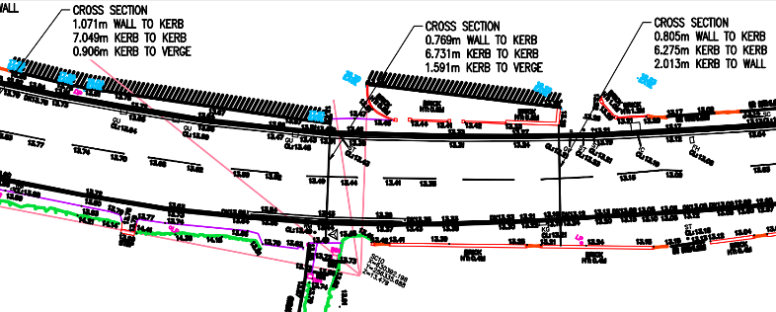
Topographical survey in June 2020
Detailed measurements of:
    Footway widths
    Carriageway widths
    Distance from building frontage to footway/kerb
    Accesses
Data used to show several typical street cross-section profiles

Slide 8
Typical Cross-Sections

Slide 9
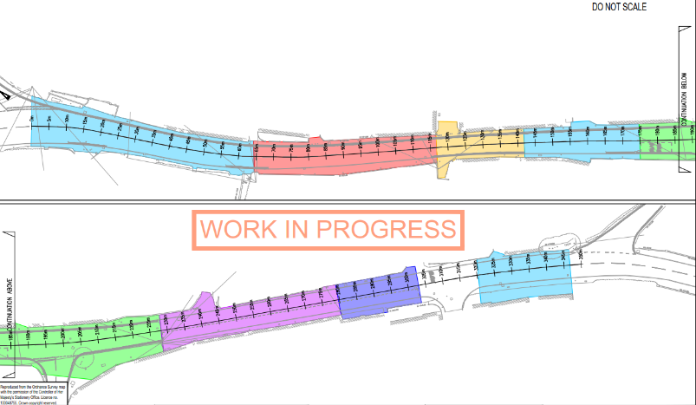
Topographical survey - June 2020
Initial indicative cross-sections taken at 8 locations
Chainage measured from Border Cot Lane junction
Border Cot
Lane
Cross-section 1
Cross-section 3
Cross-section 4
Cross-section 2
Deben Mills
Cross-section 5
Cross-section 8
Cross-section 7
Cross-section 6
Spring Lane

Slide 10
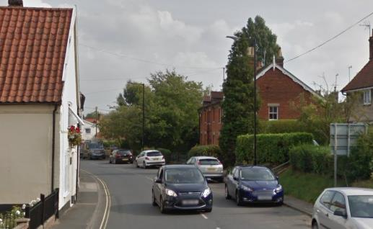
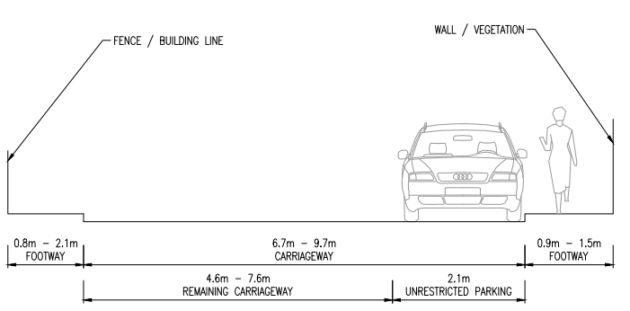
Cross-section 1 – east of Border Cot Lane (ch.0-65m)
Narrow footways on both sides; unrestricted parking on southern side

Slide 11
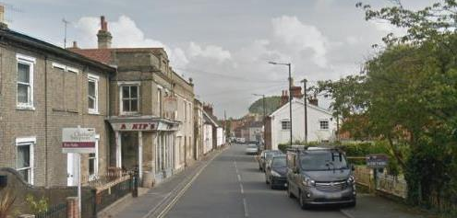
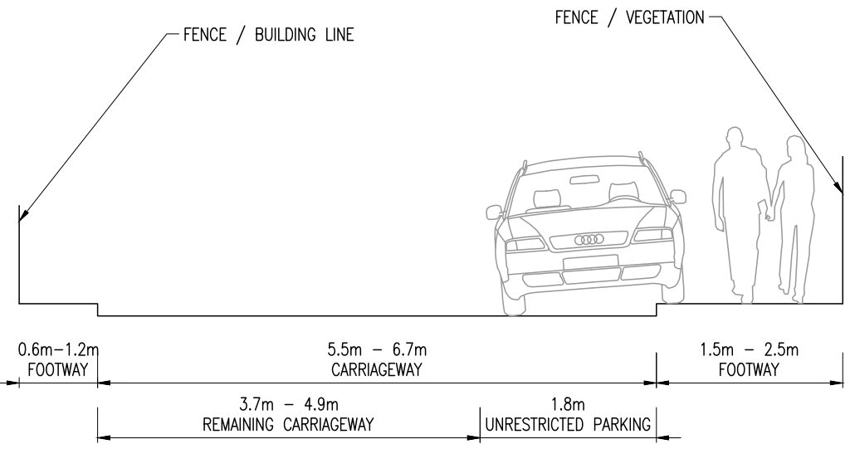
Cross-section 2 – past Hasnip’s (ch. 65-115m)
Narrow footways along both sides;
Unrestricted parking on southern side with vehicles partially on footway

Slide 12
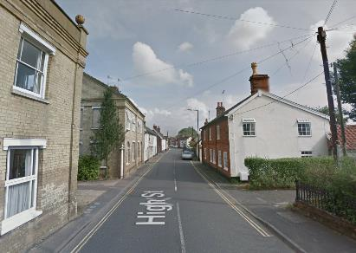
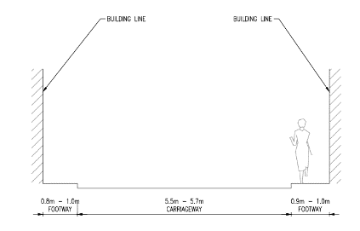
Cross-section 3 (ch.115-140m)
Narrow footways both sides; double yellows both sides

Slide 13
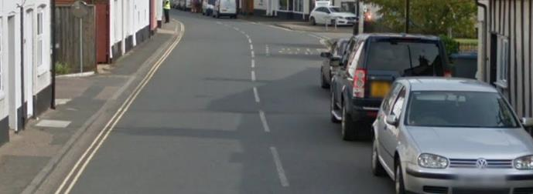
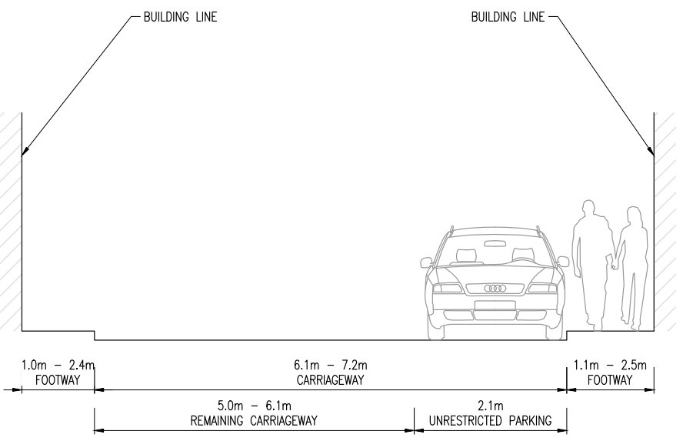
Cross-section 4 – Gospel Hall Close (ch. 140-175m)
Narrow footways both sides; unrestricted parking on southern side

Slide 14
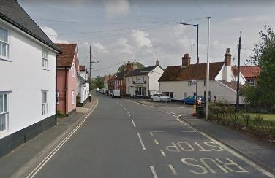
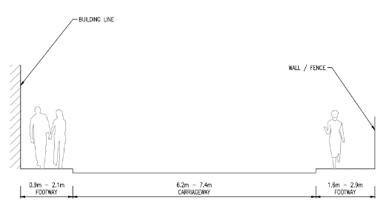
Cross-section 5 – Spring Lane junction (ch. 175-225m)
Narrow northern footway; wide southern footway with buildings set back from footway
Bus cage on westbound side; none on eastbound side

Slide 15
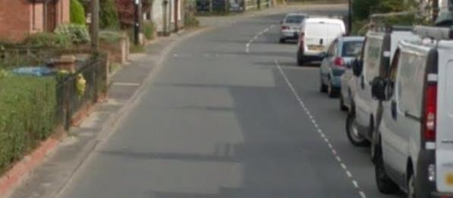
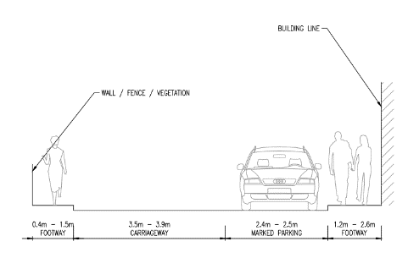
Cross-section 6 – marked bays (ch. 225-280m)
Very narrow northern footway; moderate southern footway; marked parking along southern side
Relatively wide marked parking bays
No centre line

Slide 16
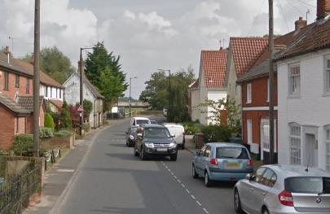
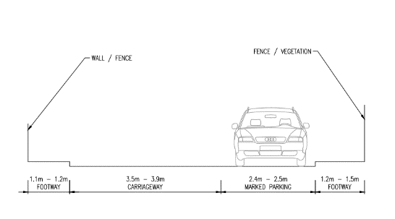
Cross-section 7 – marked bays (ch. 280-300m)
Footways of moderate width along both sides; building line set further back
Marked parking bays on westbound side

Slide 17
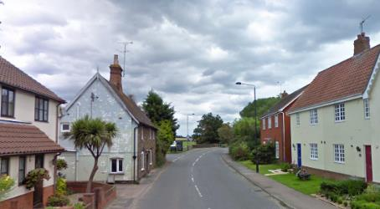
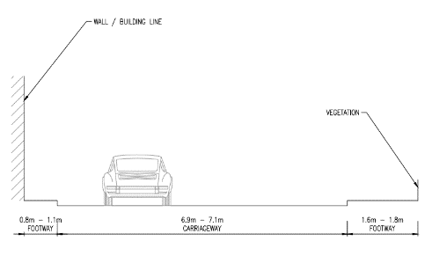
Cross-section 8 – west of Deben Mills (ch. 320-350m)
Narrow footways both sides; unrestricted parking on southern side

Slide 18
Potential Improvements

Slide 19
Traffic Calming Toolkit - Summary
Village Entry Point
Mock speed bump
    Features for pedestrian crossing
      Crossings
      Pedestrian refuge island at junction
      Overrunable footway
Coloured Surface Treatment
Kerb Build-outs
  With priority working
  Removal of Road Markings
    Speed Limit Reminder Signs
      Vehicle Activated Signs
    Features for Pedestrians
    Wayfinding
    Narrower carriageway to provide wider footway
    Features for cycling
      Advisory cycle lane
    One-way traffic shuttle movements
    Features for bus stops
    Landscaping and planting
    Junctions

Slide 20
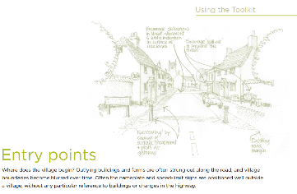
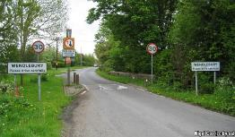
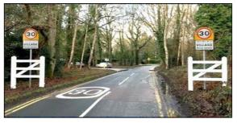
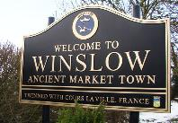
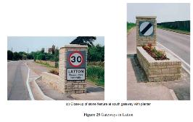
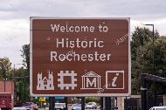
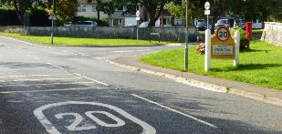
Village entry point
Modest narrowing has a psychological effect without causing congestion
Slight narrowing without obstructing traffic
Speed repeater sign
More characteristic village name sign
Cycle-friendly village
AECOM B1078 study states that a
gateway feature is already proposed
and is under discussion with SCC
Traffic in Villages
https://documents.hants.gov.uk/transport-projects/BramshawTrafficCalmingpresentation.pdf

Slide 21
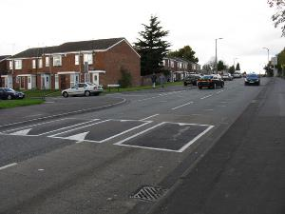
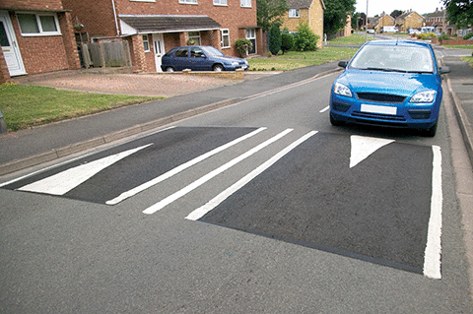
Mock speed bump
Psychological message to drivers to slow down
Not a physical measure, so no noise or vibration
https://99percentinvisible.org

Slide 22
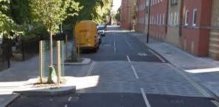
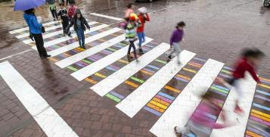
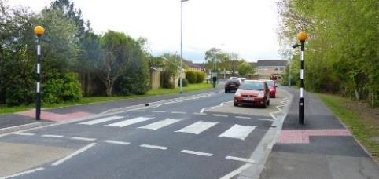
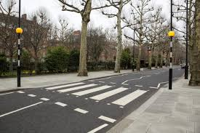
Pedestrian Crossings
Dedicated crossing point with pedestrian priority
Not a physical measure, so no noise/vibration
Source: https://www.trafficchoices.co.uk/somerset/traffic-schemes/zebra-crossing.shtml

Slide 23
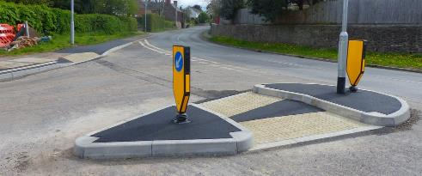
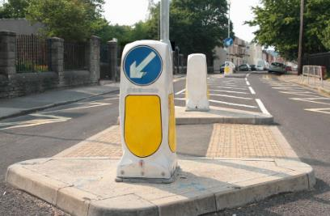
Pedestrian Refuge Island
Improvement for pedestrians:
    Narrower road therefore less distance to cross
    Easier to find gaps in traffic: only cross one lane at a time
Source: https://www.trafficchoices.co.uk/somerset/traffic-schemes/zebra-crossing.shtml
Source: https://www.trafficchoices.co.uk/somerset/traffic-schemes/zebra-crossing.shtml

Slide 24
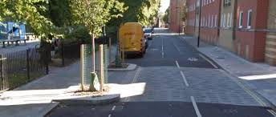
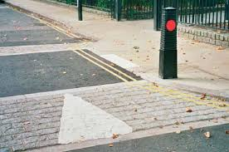
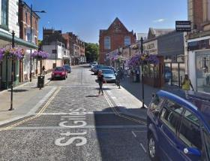
Build-out with informal crossing
Narrowing has a psychological effect on speed
(and may require one vehicle to wait, depending on size)
Improvement for pedestrians:
    Narrower road, therefore less distance to cross
    Depending on width, only one vehicle may be able to pass at a time, therefore easier for pedestrians to find gaps in traffic

Slide 25
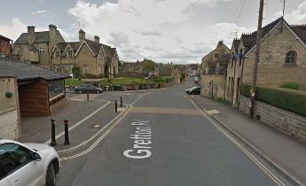
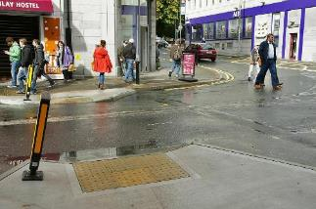
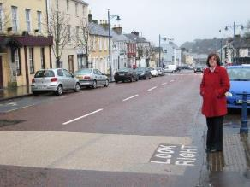
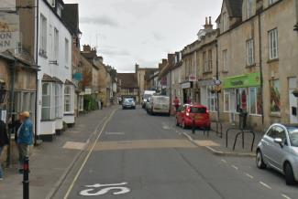
Build-out with informal crossing
Narrowing has a psychological effect on speed
(and may require one vehicle to wait, depending on size)
Improvement for pedestrians:
    Narrower road, therefore less distance to cross
    Depending on width, only one vehicle may be able to pass at a time, therefore easier for pedestrians to find gaps in traffic

Slide 26
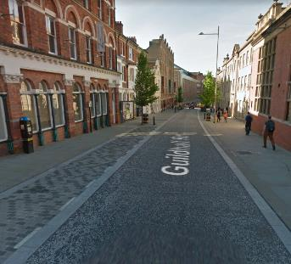
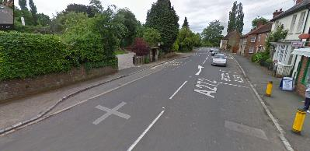
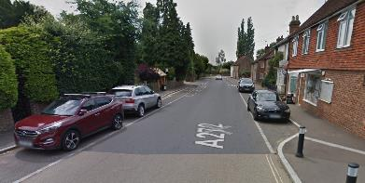
Flexible Kerbside Parking with coloured surface treatment
Use of overrunnable footways indicated by a change of surface material
Before After

Slide 27
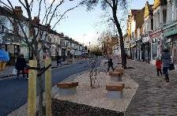
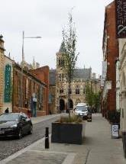
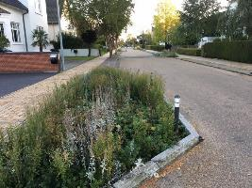
Neighbourhood Square – Landscaping and Planting
Improvement for pedestrians:
    Provision of benches and planting to enhance the pedestrian feel of the space, making it more welcoming and attractive
    Provides spaces for elderly or disabled to stop and rest
    Narrower road therefore less distance to cross
Source: https://cyclingsolutions.info/traffic-calming/

Slide 28
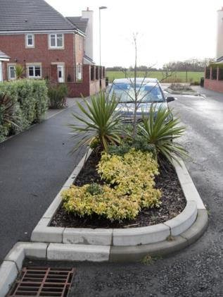
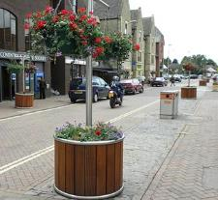
Green build-out
Protects blind accesses (left-hand side of picture)
Filled with vegetation – more attractive, and potential for community involvement
Backed up by bollards to enforce its purpose
Source: North Tyneside

Slide 29



Narrow carriageway to provide additional footway
Reducing the size of the carriageway, providing priority to pedestrians and cyclists
Use of overrrunnable footways indicated by a change of surface material

Slide 30


Tighter kerb radii
Increase visibility for vehicles
Tighter turning meaning vehicles must slow down when approaching and taking the corner
Improvement for pedestrians: narrower road therefore less distance to cross
Source: https://www.trafficchoices.co.uk/somerset/traffic-schemes/new-footway.shtml

Slide 31



Junctions redesigns
B1078 / Border Cot Lane – options for a mini roundabout
Poynton, Cheshire
Source: https://www.theguardian.com/cities/2019/mar/18/ben-hamilton-baillie-obituary

